Slide 1
An Aimsir Láithreach - The Present Tense
The present tense talks about things
that happen everyday (Gach la…).

Slide 2
An Aimsir Láithreach:
The present tense talks about things happening regularly:
ie. everyday, every week, every month, every year etc.
Broad + Slender:
The vowels are divided into 2 groups –
Broad = a, o, u. Slender = i, e.

Slide 3
An Aimsir Láithreach:
All verbs are either broad or slender, depending on the last vowel in the stem.
eg. Tóg (to take) = Broad
Glan (to clean) = Broad
Bris (to break) = Slender
Caill (to lose) = Slender
Broad verbs need broad endings.
Slender verbs need slender endings.
Notes:
Remember, broad verbs need broad endings. (3) An Aimsir Fháistineach – The Future Tense
The future tense talks about things that will happen.
Remember, Broad verbs need broad endings.
Slender verbs need slender endings.
Slender verbs need slender endings.

Slide 4
An Aimsir Láithreach:
Present Tense Rule:
Stem of verb + correct ending.
Remember: The stem of the verb is just the verb in its simplest form. ie. “to” do something. eg. Cuir = to put.
Endings:
All endings are either broad or slender.

Slide 5
An Aimsir Láithreach:
Broad – Slender –
-aim -im
-ann tú -eann tú
-ann sé/sí -eann sé/sí
-aimid -imid
-ann sibh -eann sibh
-ann siad -eann siad

Slide 6
An Aimsir Láithreach:
ex. I take the bus to school everyday =
T ó g a i m an bus ar scoil gach lá.
B + B Broad stem, broad ending.
I break the rules in school everyday =
B r i s i m na rialacha ar scoil gach lá.
S + S Slender stem, slender ending.

Slide 7
An Aimsir Láithreach:
Nóta: There are 2 main types of verbs in Irish. The above applies to 1-syllable verbs.
eg. Fan – To stay, Bris – To break
There are also 2-syllable verbs though, most of which end in
–igh or –aigh.
eg. Cuidigh – To help, Ceannaigh – To buy.

Slide 8
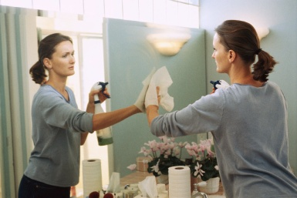
Let’s practice our 1-syllable verbs before we move on!
Glan (B) - To clean
Glanaim
Glanann tú
Glanann sé/sí
Glanaimid
Glanann sibh
Glanann siad
Cuir (S) – To put
Cuirim
Cuireann tú
Cuireann sé/sí
Cuirimid
Cuireann sibh
Cuireann siad

Slide 9
An Aimsir Láithreach:
Right, now let’s deal with the 2-syllable verbs. For these verbs, the present tense rule is basically the same, but the endings are different. Examples of 2-syllable verbs are:
Ceannaigh - To buy l
Críochnaigh – To finish l infinitives
Bailigh – To gather l
Cuidigh – To help l

Slide 10
An Aimsir Láithreach:
Above, you have been given the infinitive of some verbs. You have to create the stem from this though, before you can add endings.
To do this, you just knock off either the –igh or –aigh. Only then do you decide if the verb is broad or slender.
Have a look at some examples:

Slide 11
An Aimsir Láithreach:
Infinitive: Stem:
Ceannaigh > Ceann B
Críochnaigh > Críochn B
Bailigh > Bail S
Cuidigh > Cuid S
Just like we saw with the 1-syllable verbs,
a broad verb needs a broad ending and
a slender verb needs a slender ending.

Slide 12
An Aimsir Láithreach:
Endings for 2-syllable verbs:
Broad – Slender –
-aím -ím
-aíonn tú -íonn tú
-aíonn sé/sí -íonn sé/sí
-aímid -ímid
-aíonn sibh -íonn sibh
-aíonn siad -íonn siad

Slide 13
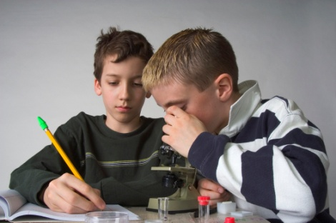
An Aimsir Láithreach:
Tosaigh (B) - To start
Tosaím
Tosaíonn tú
Tosaíonn sé/sí
Tosaímid
Tosaíonn sibh
Tosaíonn siad
Oibrigh (S) – To work
Oibrím
Oibríonn tú
Oibríonn sé/sí
Oibrímid
Oibríonn sibh
Oibríonn siad

